Slide 1

Reconstructing Historical Singing: Reality or Fantasy?
Richard Wistreich

Slide 2
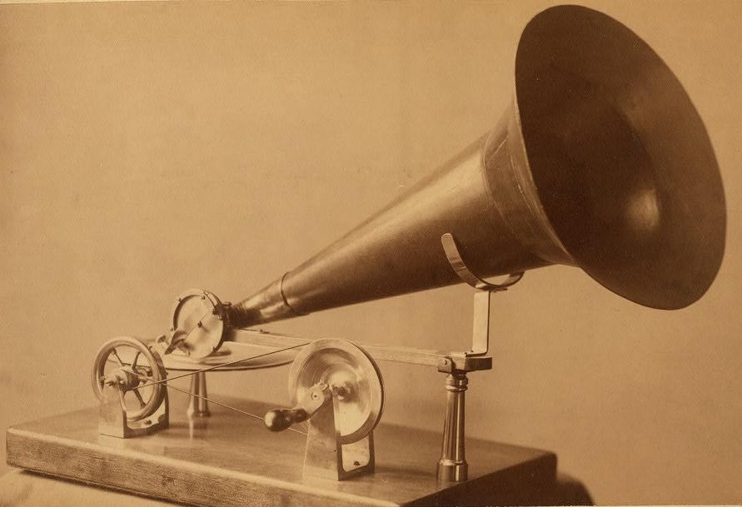

Slide 3
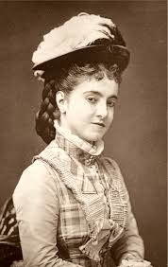

Slide 5
René Jacobs, Le Monde November 1993:
‘Il n’y a pas de voix baroque. Contrairement aux instruments qui vieillisent et se modifient, la voix, elle, n’évolue pas. La seule chose dont on soit sûr, c’est que les voix d’aujord’hui, sont indentiques à celles d’autrefois’.

Slide 6
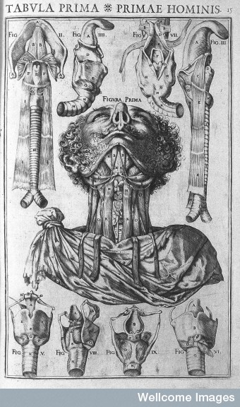

Slide 8
Bénigne de Bacilly, Remarques curieuses sur l’art de bien chanter (Paris, 1668), 33:
‘Il y a trois choses pour parvenir à bien chanter... à sçavoir, la Voix, le Disposition & l’Oreille, ou l’Intelligence’.
Notes:
Three things: voce, disposition, ear, or intelligence

Slide 9
Aristotle, De Anima: ‘Voice is a kind of sound characteristic of what has soul in it; nothing that is without soul utters voice’.

Slide 10
Casserius (1600): ‘speech is the interpreter of our reasoning and intellect, the unfolder of all our conceptual thoughts, and, in the like manner, the active component of our soul? For our verbal expressions are the indices to the passions of our beings’.

Slide 11
Pierre de la Primaudaye, Suite de l’academie francoise (1580)
‘Our soule useth thoughts and discourses which, cannot be declared as long as it is inclosed in this tabernacle of flesh…And so wee say that there are two kindes of speech in man, one internall and of the minde, the other externall, which is pronounced, that is the messenger of the internall, that speaketh of the heart. Therefore that which is framed in voice, & brought into use, is as a river sent from the thought with the voice, as from his fountain’.
‘… the head of the rough artery, commonly called the knot or joint of the neck or Adams morsel, being fashioned like to an Almain flute’

Slide 12
Ottavio Durante, Arie devote, le quali contengono in se la maniera di cantar’ con gratia, l’imitation’ delle parole, et il modo di scriver passaggi, et altri affetti (Rome, 1608)
‘Singers must strive to grasp the sense of what it is they have to sing, especially when singing alone, so they can understand it in themselves and make it their own, in order to be able to bring their listeners to the same understanding, which is their principal purpose. They must take care to sing in tune, to sing adagio (that is, with great freedom of rhythm), to give forth the voice with gratia and to pronounce the words distinctly in order to be understood, and if they want to add passaggi they should remember that not every passaggio is suitable for good maniera in singing’.

Slide 13
Marin Mersenne (1636): ‘le larynx monte en haut quand nous chantons le Dessus. … le larynx descend en bas en chantant la Basse’.
Jean Antoine Bérard (1755): “Les Observations apprennent que le Larinx monte tout entier dans les Sons aigus, & qu’il descend dans les Sons graves...& que les degrés d’abaissement sont exactement dans les mêmes proportions, que les degrés d’élevation dans les Sons aigus. On peut se convaincre de la verité & l’exactitude de ces proportions, en portant le doigt sur le Larinx, lorsqu’on rend des Sons aigus ou graves”

Slide 14
Mersenne (1636) ‘Et la flexibilté de la voix n’est austre chose que la facilité & la disposition qu’elle a à se porter par toutes sortes de degrez & d’intervalles tant en montant, qu’en descendant, & en faisant toutes sortes de Passages, & de diminutions’
Bacilly (1668) ‘Disposition ... est une certaine facilité d’executer tout ce qui consiste la Maniere de Chanter, & qui a son siege dans le gosier’

Slide 17
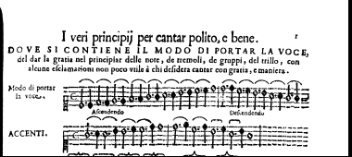
Francesco Rognoni (1620)

Slide 18
Notes:
Tremolo / trill

Slide 19
Lodovico Zacconi (1592) ‘The tremolo, that is, the trembling voice, is the true door for entering into the passaggi and for mastering the gorgie, because a ship sails more easily once it is already in motion’

Slide 20
Zacconi (1592):
‘Two things are necessary to whoever wishes to practise this profession - chest and throat; chest in order that a great quantity and number of figures can be carried through to the proper end; throat to be able to deliver them with facility’.

Slide 21
